Slide 1
NEXT जन Transport System
A course project of Cs-684 Embedded System
Under guidance of -
Prof. Kavi Arya
Mr. Lohit Penubaku
Abhijit Divekar (163079036)
Ajaykumar Maurya (16307R009)
Punit Jain (17307R016)

Slide 2
Problem Statement
To Effectively convey LOCATION OF EACH AND EVERY BUS TO THEIR Respective stops.
To Extract location of relevant Buses at the bus-stops.
To Calculate Estimate Time of Arrival(ETA) for each bus at Their Respective bus-stops.
To Display the location and their estimated Time of arrival at the bus-stops.

Slide 3
Requirements
GPS module to provide Real-time location (NEO 6m-gps module ).
Hardware module that can communicate over Radio frequency and internet (esp-lora-32).
Computational module (raspberry-pi).
Database to store chunks of data (aws iot framework).

Slide 4
Project plan {Plan followed to execute the task}
Initially we interfaced Neo-6m gps module with Esp-lora-32 module to fetch real time location.
This information is then communicated over rf (433 mhz) with the help of ESP-lora-32 module.
the received data is then store in an online database of Aws Dynamodb.
Ras-pi is used to compute the Eta and current location.
Real-time location display on google maps.

Slide 5
Block Diagram

Slide 6
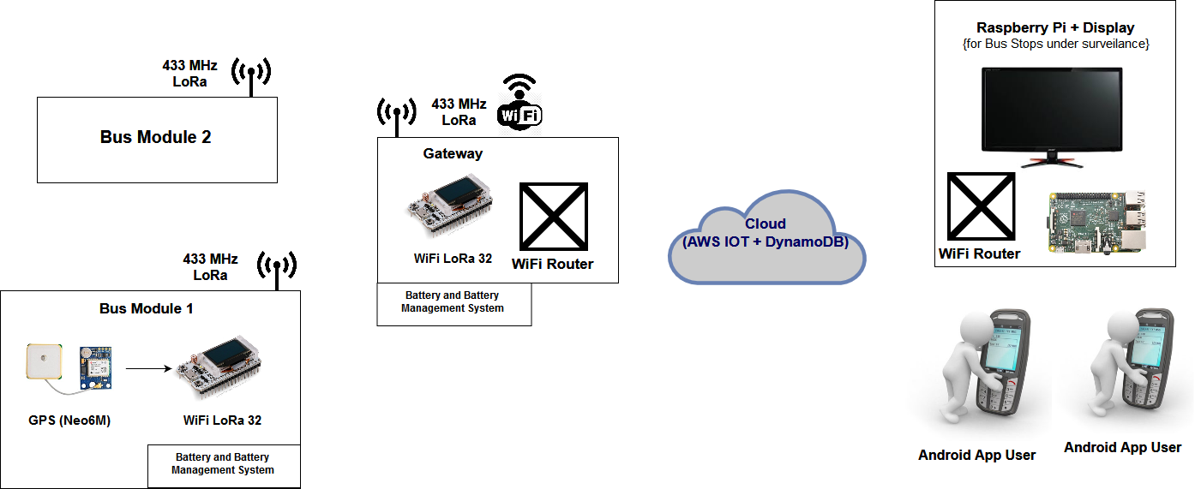

Slide 7
Innovation
Currently there is no such deployed system.
Free of cost from users perspective.
Cost effective solution for bus-service providers.
can be used in rural areas where broad-band services are not prevalent.
No hardware at bus-stops except displays.

Slide 8
challenges
Getting familiar with esp-lora-32 architecture.
Rf communication between 2 modules.
Accessing AWS Dynamodb database .
Publish/ subscribe data on mqtt broker.
Getting data from google api’s.
App development.

Slide 9
Task completed
Successful communication over the rf was achieved using sdk and datasheet.
A non-line of sight distance of about 1 kilometre was observed.
CRUD (create, read, update, delete) of AWS database using aws tutorials.
Google api’s for eta and reverse geo-coding using google documentation.
Proof of concept for the proposed solution.
Prototype of the overall system.

Slide 10
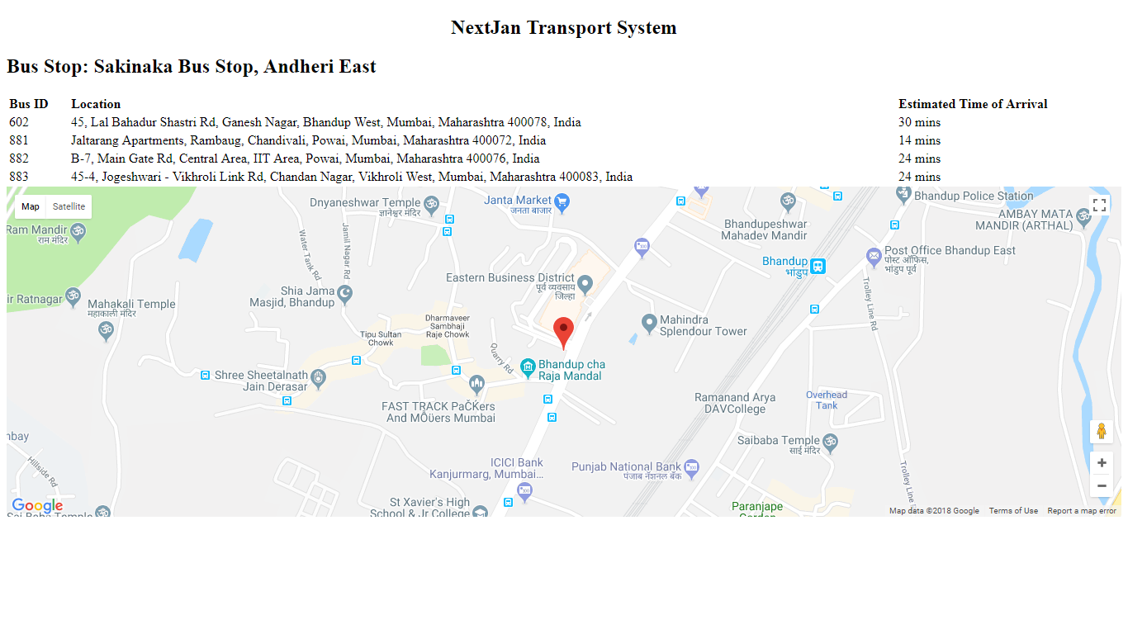
Test cases & Final output

Slide 11
reusability
Extra nodes (transmitter and gateway) can be added without any prior request.
Any addition of a new bus-stops does not require any extra setup except display.
Long distance communication can be also be done using power amplifier.
Can also be used as a sensor network for some other applications.

Slide 12
Future enhancements
Android app development.
Power amplifier for long range.
Expansion of this network for real-time scenario.

Slide 13
THANK YOU.

